Slide 1
Prime of an NBA Career
Cooper Handelsman

Slide 2

Research Question
Is the prime of an NBA player at age 27?
Has this prime changed over the last thirty years?

Slide 3
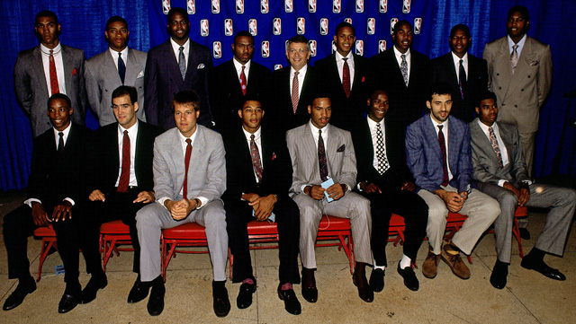
Subjects
38 participants in total
3 different draft classes: 1979, 1989, 1990
Must have played in every season from age 24-30

Slide 4
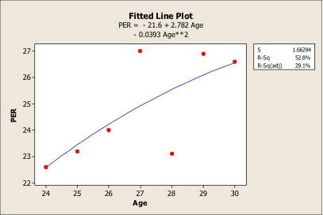
Statistics
Four different statistics: PER, PPG, APG, RPG
To find the peak, there are two different methods
  Fitted line plot
  with quadratic
  model
  Picking the best
  season

Slide 5
Tests
Five test were run in order to test hypothesis
  For the prime of the career:
    1-sample t-test
    Wilcoxon signed rank
  For the differences between decades:
    1-sample ANOVA
    Kruskal-Wallis
    Multiple Comparisons (Steel-Dwass-Critchlow-Fligner )

Slide 6
1-sample t-test
Procedure done 8 times
H₀: μ = 27 vs. H₁: μ ≠27.
t statistics: -2.16 to -3.91
P-values: 0.00 to 0.037
Reject the null for all tests, mean is significantly different than 27

Slide 7
Wilcoxon Signed-rank
Performed 8 times
H₀: θ=0 vs. H₁: θ≠0
Wilcoxon test statistics: 68.5 to 117
P-values: 0.0 to .028
Reject the null for all tests, the median is significantly different from 27

Slide 8
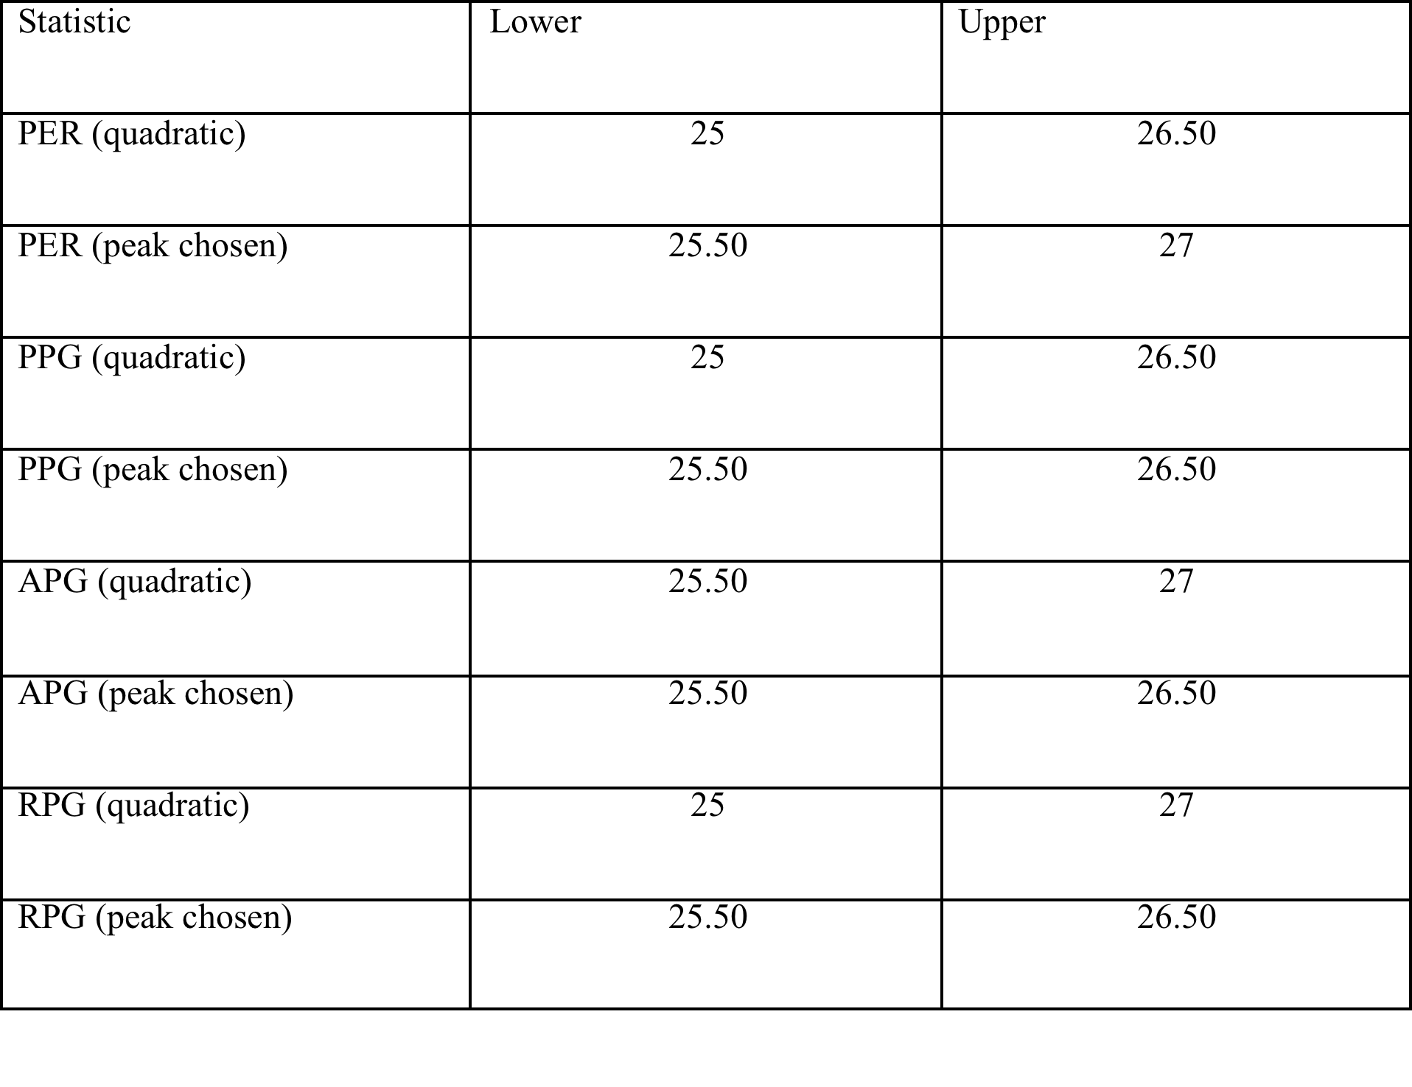
Confidence Intervals

Slide 9
Differences Between the Decades
Three decades represented: 1980, 1990, 2000
Peak is not important, it is just comparing the peaks regardless of what it is
ANOVA and Kruskal-Wallis

Slide 10
ANOVA
Four assumption that are all met
H_{0:} μ₁₉₈₀= μ₁₉₉₀= μ₂₀₀₀ vs. H₁: μ₁₉₈₀≠ μ₁₉₉₀≠μ₂₀₀₀
PER: F-statistic of 2.06, p-value of .129
PPG: F-statistic of 1.50, p-value of .225
APG: F-statistic of .64, p-value of .53
RPG: F-statistic of 4.06, p-value of .018

Slide 11
Kruskal-Wallis
H₀: T₁₉₈₀=T₁₉₉₀=T₂₀₀₀ vs. H₁: not all T_{j}’s are equal
PER: H-value of 4.89, p-value of .087
PPG: H-value of 3.51, p-value of .172
APG: H-value was .35, p-value of .84
RPG: H-value of 14.14, p-value of .001

Slide 12
Multiple Comparisons
Steel-Dwass-Critchlow-Fligner test
T_{u} ≠ T_{v} if w*_{I j} ≥ w* _{α}
1980 and 1990: w*_{ij}=-13.0508
1990 and 2000: w*_{ij}=- 9.1199.
1980 and 2000: w*_{ij}=- 21.7149

Slide 13
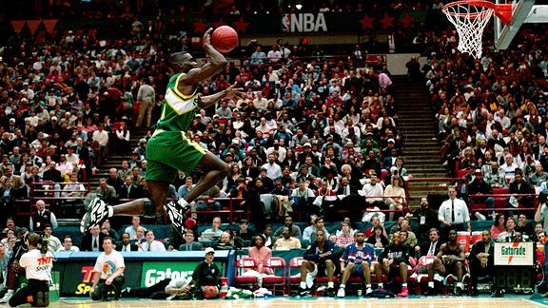
Conclusion
The prime of an NBA player’s career is not at age 27
The prime for a player has not changed in the last thirty years, except for rebounding

